Slide 1
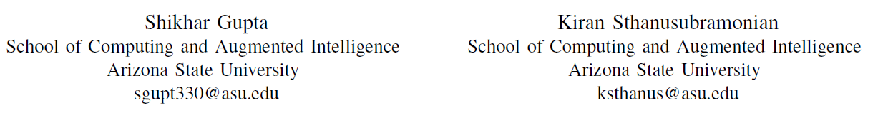
CSE 534 SLN 98070, Fall 2022 Advanced Computer Networks
Dynamic Routing using P4 Switches and the FABRIC Measurement Framework
Authors:

Slide 2
Problem Statement
Setting up a Dynamic Routing Experiment for simple network topologies on the FABRIC Testbed.
Use P4 to create a programmable switch backbone.
Create a dynamic routing algorithm which leverages:
FABRIC Measurement Framework Library (MFLib): collect node-level metrics,
Aggregate the metrics at the Controller to find an optimal routing path between two hosts on the network,
P4 Runtime: dynamically configure the optimal routing path on the switch topology.

Slide 3
Related Works
P4 in general:
DDoS Attack Prevention
Load balancing
Caching on the Data Plane
P4 for dynamic routing solutions:
RouteScout: Hybrid System for BGP Routing
The In-band Network Telemetry (INT) Specification:
Very popular implementation of P4
Efficient network monitoring systems using INT developed

Slide 4
P4
De facto method for data plane programmability.
Extension to Software Defined Networking (SDN).
Help to realize OpenFlow 2.0
Tackle Protocol Ossification
Hardware Independence.
Advantages:
Active Networking - increase in compute and storage power
Critical in building robust & secure networks in real-time!

Slide 5
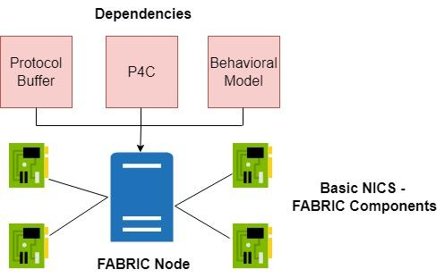
P4 - FABRIC Implementation
FABRIC Nodes are converted to ad-hoc P4 Switches. How?

Slide 6
P4 - Our Usecase
A simple Routing P4 Program is compiled and deployed on each switch on the network. Target: simple-switch
IPv4 based Routing Table:
Key: Destination IPv4 Address,
Parameters: next_hop MAC Address, Egress Port #
P4 Match-Action Table commands of interest:
table_add: adds a new table entry
table_modify: modifies a table entry of an existing handle
table_delete: deletes a table entry of an existing handle

Slide 7
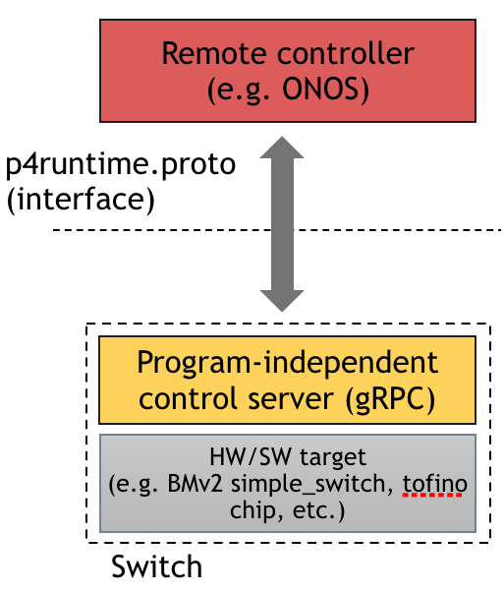
P4Runtime
Control Plane Specification for P4
Two popular workflows:
Set Forward Pipeline Information
Get Forward Pipeline Information

Slide 8
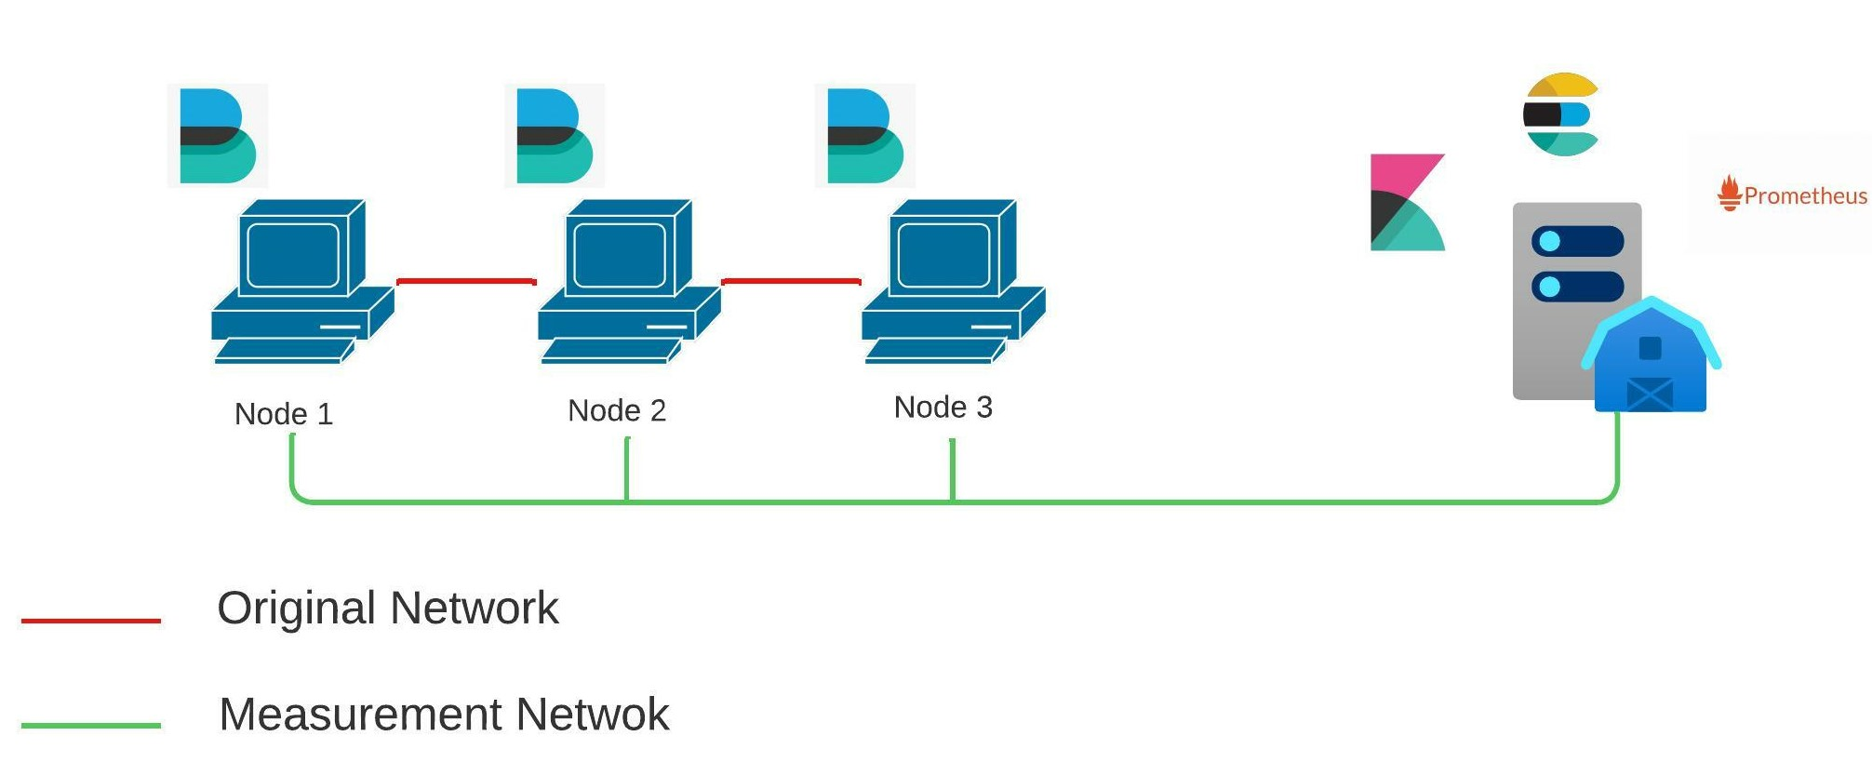
FABRIC Measurement Framework Library
Prometheus: Metrics Collection
Elasticsearch: Stores the Metrics
Kibana & Grafana: Dashboards and Visualizations

Slide 9
Additional Tools used
Scapy: Python module for Traffic Generation & Packet Sniffing
Prometheus Client: Used for writing customized queries to extract real-time metrics gathered on the Measurement Node

Slide 10
Dynamic Routing Algorithm
Incoming packet transmission request between two hosts to the controller.
Controller sets the optimal routing path among multiple available routes between the hosts:
Query & Aggregate the available bandwidth / queueing buffer size on each egress ethernet interface present on the routes
Optimal Route: Path with Maximum Available Bandwidth / Minimum Queuing Buffer Size
Configure the Optimal Route on the P4 Switches using P4Runtime

Slide 11
Dynamic Routing Algorithm - Assumptions
The available routing paths between any two given hosts are known beforehand.
Limited number of available routing paths between the two hosts.
Complete information about the ingress and egress ports of the network devices available to the Controller.

Slide 12
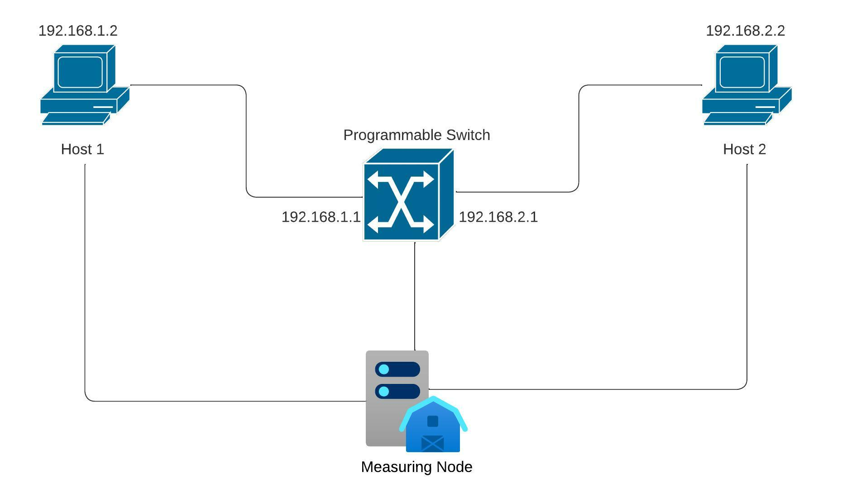
Experiment #1

Slide 13
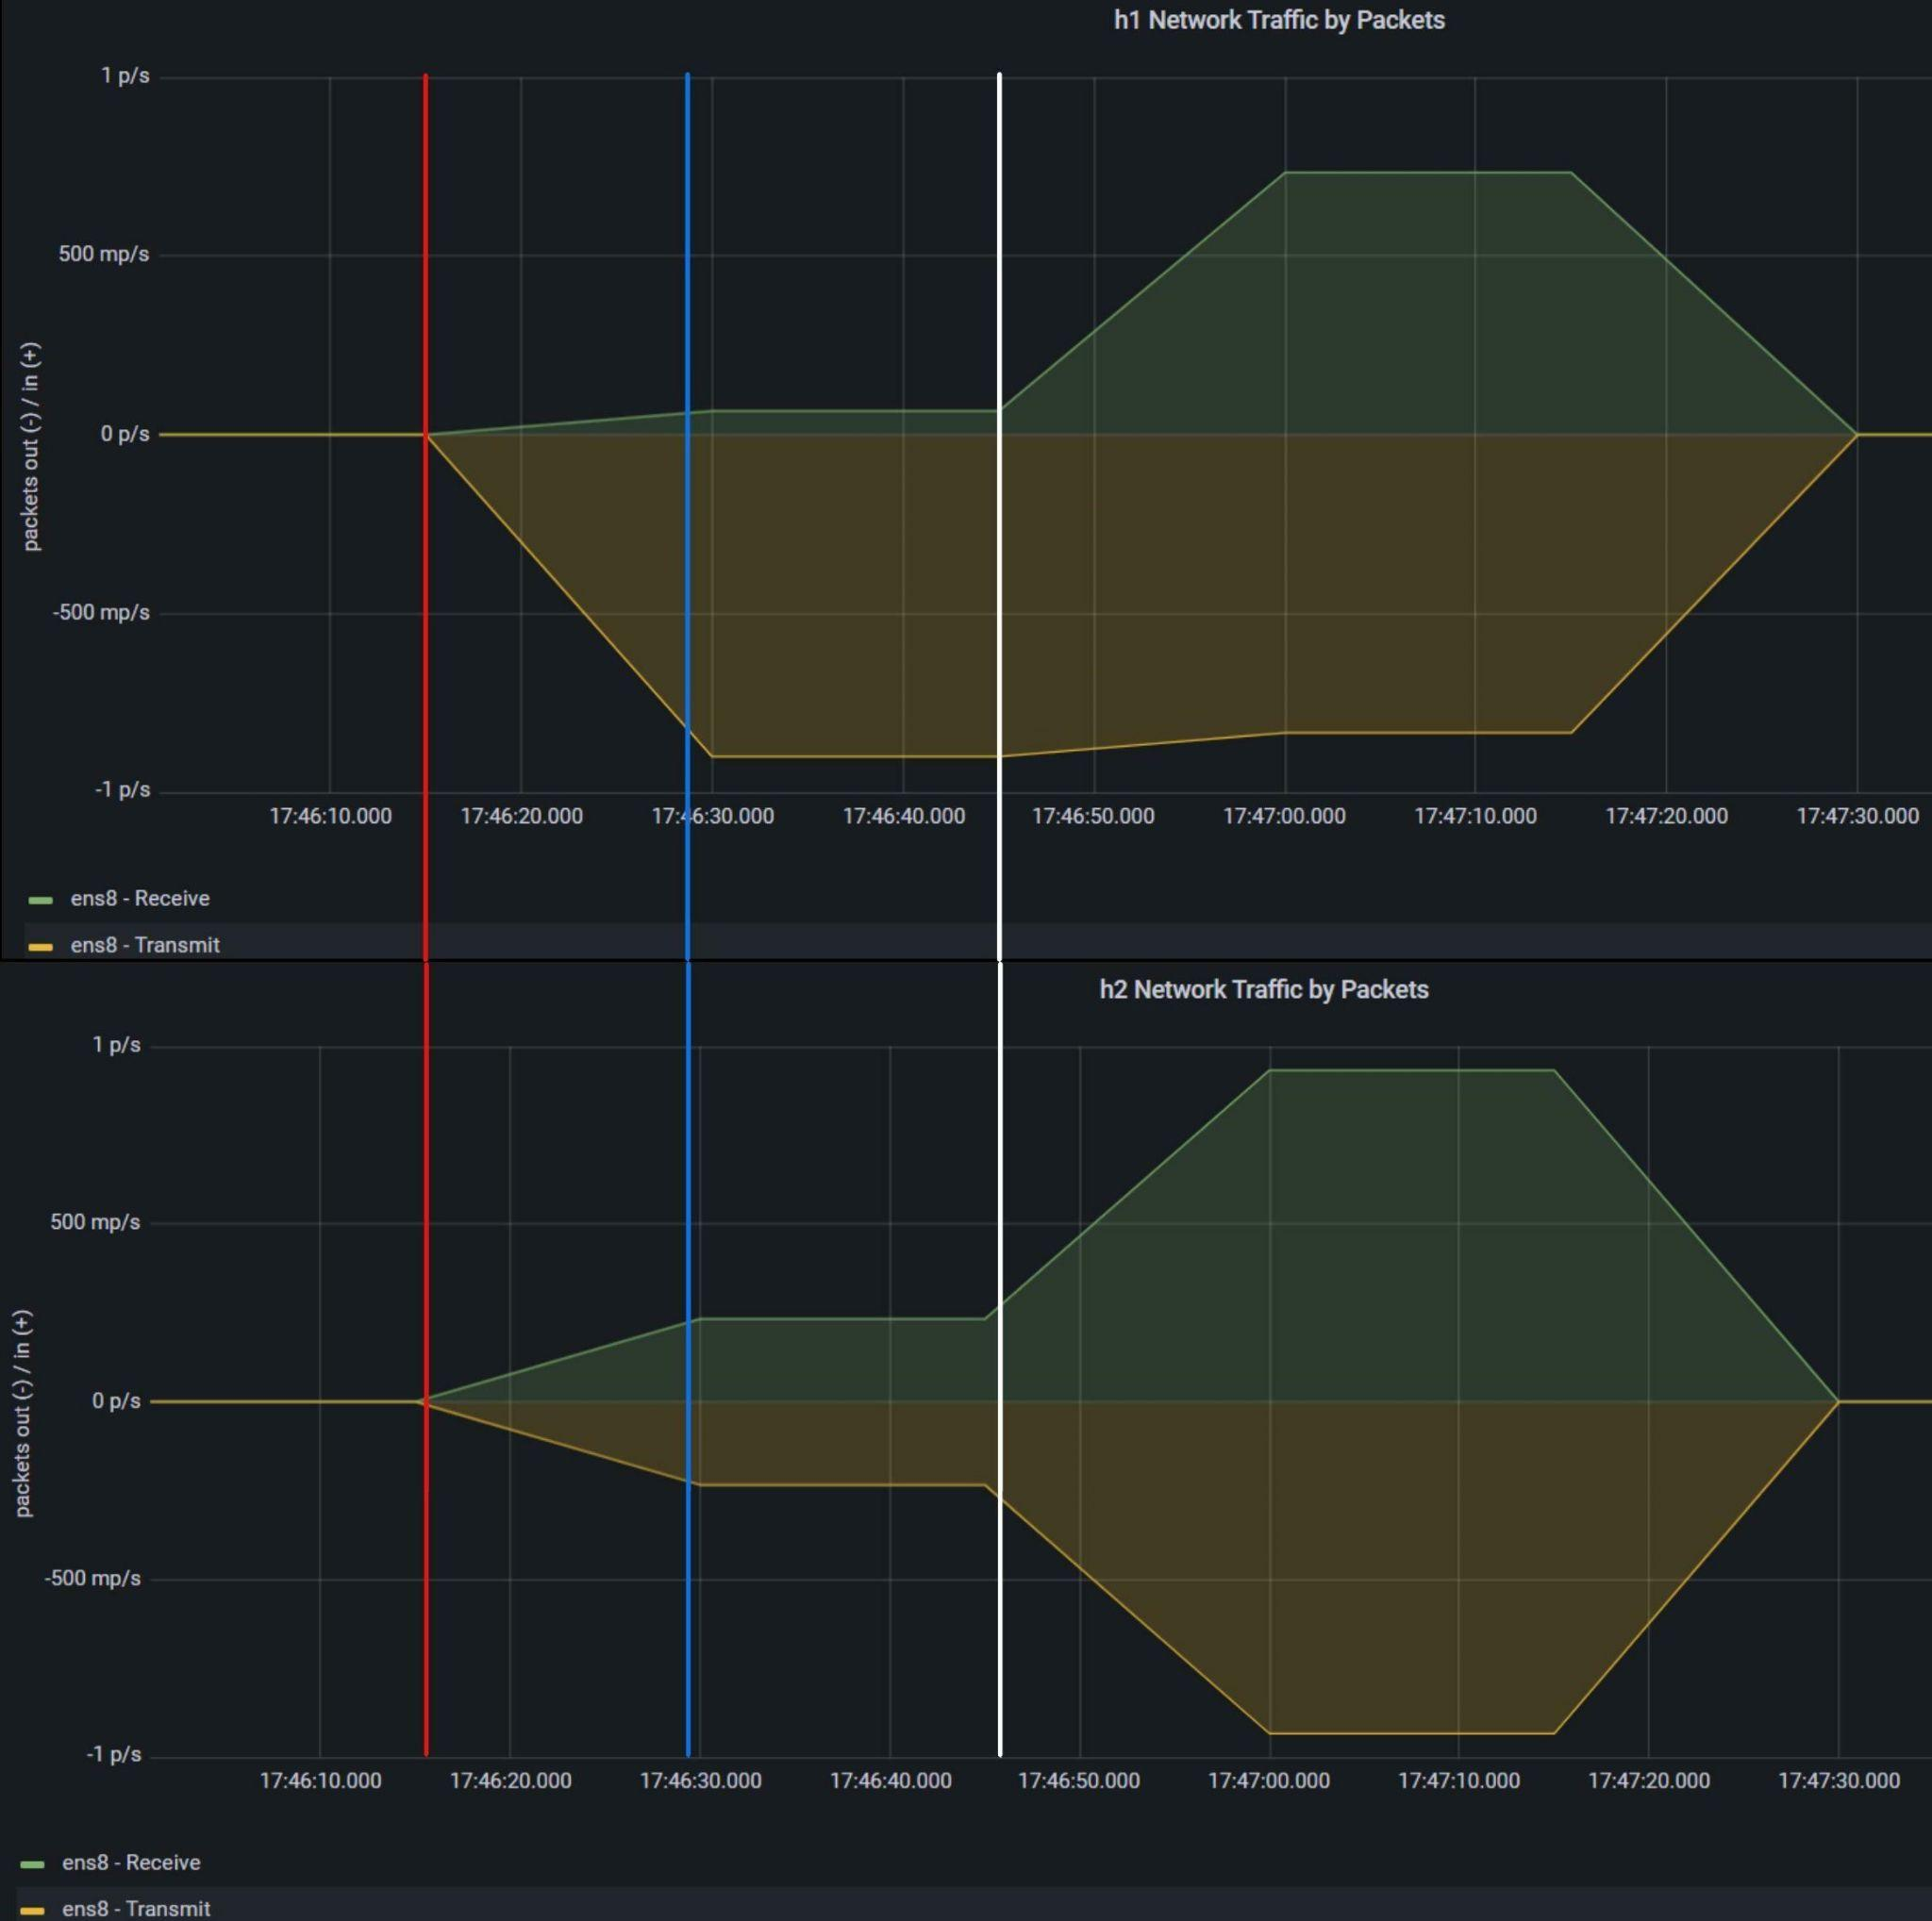
Experiment #1 - Results

Slide 14
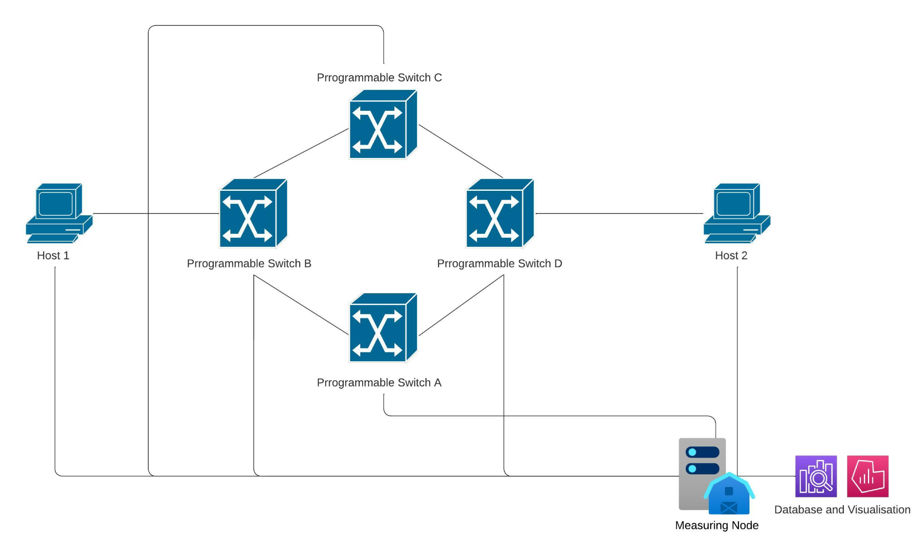
Experiment #2

Slide 15
Experiment #2 - Expected Results
Compare the Round-trip Time (RTT) between the hosts:
without the Dynamic Routing algorithm - use pre-configured route / pick any arbitrary route,
with the Dynamic Routing algorithm.
Visualize the slice-level Throughput using MFLib & Grafana.

Slide 16
Challenges Faced
Setting up MFLib:
Minimal codebase documentation
Required to change few minor implementations on the codebase
Dependency issues with Python versioning
We had to find the required credentials used for accessing Prometheus Client running on the Measurement Node
Insufficient resources on how to deploy P4 Programs / P4Runtime / modifying match-action table entries, etc.

Slide 17
Remaining Tasks
Implement the Optimal Route Finding algorithm & conduct necessary experiments:
The Prometheus queries are ready!
Implementing P4Runtime on the FABRIC Testbed:
An alternative approach using FABRIC Library (FABLib) Commands has been successfully implemented!

Slide 18
Potential Improvements
Use Explicit Congestion Notification (ECN) to detect congestion on one path:
With ECN, we can reconfigure to an optimal routing path only when necessary.
ECN can be implemented using P4.
Minimizes path configuration requests.
Repeatedly aggregate and cache the metrics on the Controller to make faster route reconfigurations.

Slide 19
Our Contributions
Dockerize the entire P4 & P4Runtime custom implementation on FABRIC.
Open-source our implementation for setting up customized topologies with setup of MFLib.

